Slide 1
Course Intro
Data Structures Primer

Slide 2
What are ADTs?
ADTs or Abstract Data Types is a programming model of a data structure which has well-defined behaviors
Examples of ADTs:
Arrays
Stack
Queue
Linked list
Tree

Slide 3
Basics Operations of Data Structures
For any data structure, there are a set of required operations/functions/methods that can be called
Access
Insert
Delete
Find
Sort

Slide 4
Before Big-O
Limits & Asymptote
A limit is the value that a function “approaches” as the input “approaches” another value
An asymptote of a curve is the line that which distance between the curve and the line approaches zero as either the x or y “approaches” a value, usually infinity.

Slide 5
Big O
Big O is a mathematical notation that describes the limits of a function
Big O is used in computer science to classify algorithms and data structure based on their run time or space requirements as the number of inputs grow

Slide 6
Python Classes, Methods, and Objects
Python is an object-oriented programming language
All related code is implemented into a construct or ‘container’ called a class
Classes have ‘objects’ what have a variable and behavior associated with them
Methods are functions of the class that perform actions

Slide 7
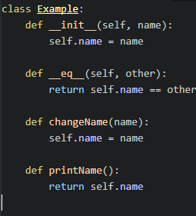
Example of a basic class

Slide 8
Useful methods for classes
__init__
Used to setup the class and the objects
__eq__
Allows the usage of == for comparison testing
__repr__ OR __str__
Nice ways of output the objects in your class

Slide 9
Testing
As a computer scientist, its important to test your code with different scenarios to insure that your code works in ALL situations
Edge/Corner cases
An edge or corner case is a situation that occurs outside the normal operating parameters, usually when the variables are at extreme values or incorrect values

Slide 10
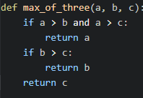
Consider the following

Slide 11
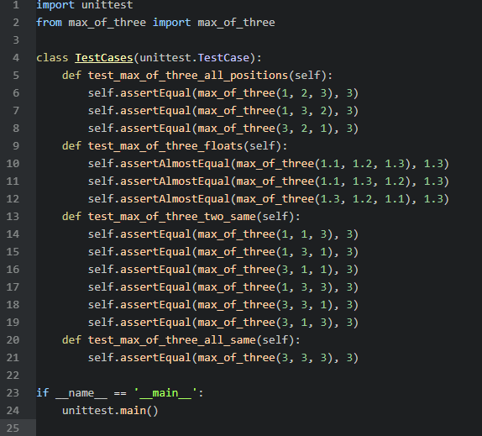
Tests cases

